Slide 1

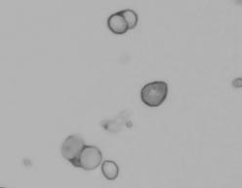
Single Cell Sample Preparation
Diana Burkart-Waco, PhD
dburkart@ucdavis.edu
SRA at UC Davis DNATECH Core
https://dnatech.genomecenter.ucdavis.edu/

Slide 2



General Workflow
Tissue dissection
Fast, reliable, clean.
Mechanical mincing
Trituration, razor blade, etc.
Enzymatic breakdown
E.g. Trypsin, dispase, collagenase)
Often with agitation
Obtain cell interest (flow)
Remove dead cells (beads, etc.)
Cell enrichment
(optional)

Slide 3
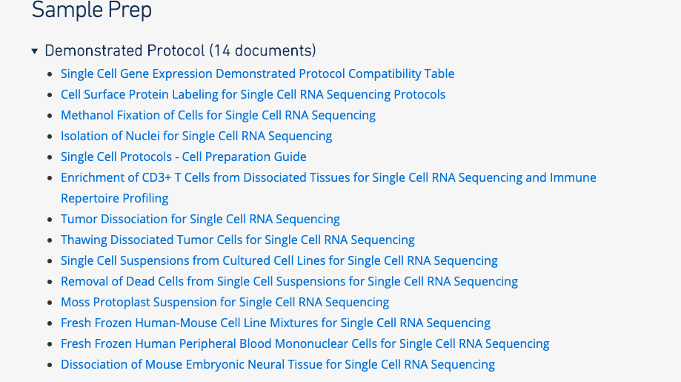
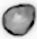
Cell isolation
Cell isolation guides available at:
https://www.support.10xgenomics.com/single-cell-gene-expression/sample-prep/
Cell isolation → biggest source technical variation.
Dissociation and preparation depends on cell type.

Slide 4
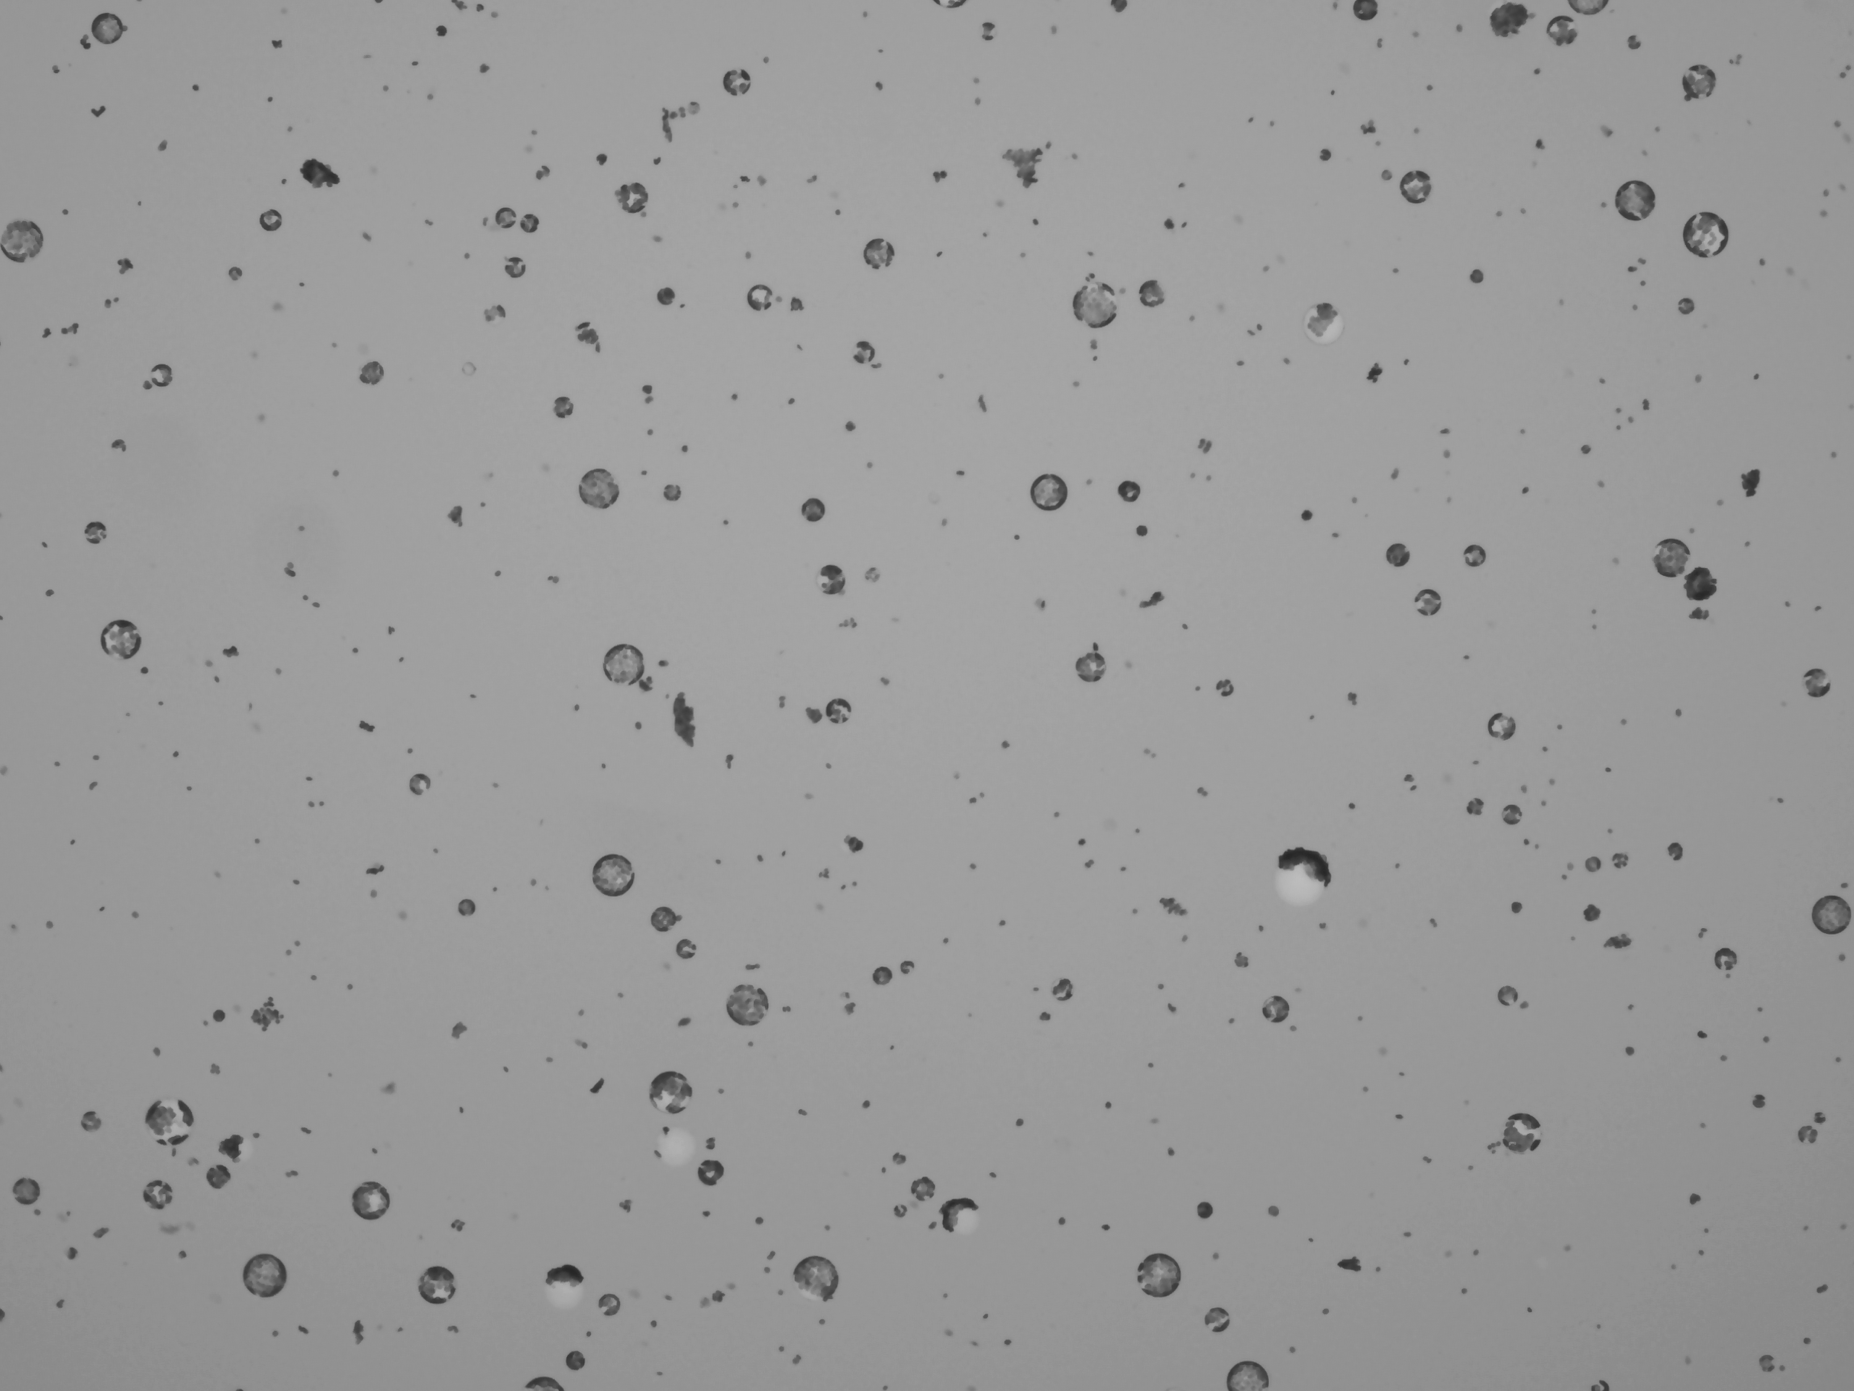
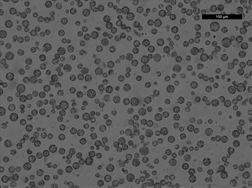
Tissue Dissociation
Many ways to dissociate tissue:
Mechanical
Enzymatic
Automated blending
Microfluidics devices
Considerations:
Speed
Consistency in results
Good representation of all cell types
Arabidopsis protoplasts
Same method, different days.

Slide 5

Factors Influencing Dissociation
Unfortunately, SC sample optimization is best achieved through trial and error…

Slide 6

Single cell vs. nuclei
Single cell captures more transcripts, but is a harder protocol.
When to use nuclei:
Cells cannot be harvested intact or viable (e.g. adipocytes, neurons).
Cells are too big for capture (e.g. cardiomyocytes).
Tissue frozen.
Tissue dissection
Detergent
Grinding
Cell lysis
Flow cytometry
Density Gradient
Nuclei purification

Slide 7
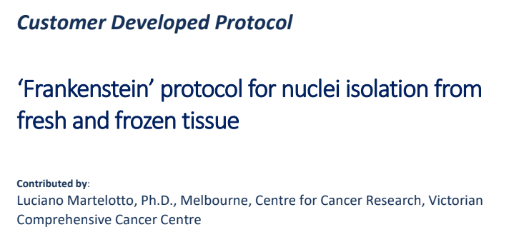
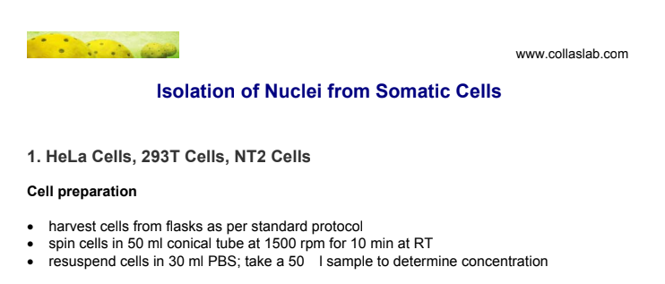
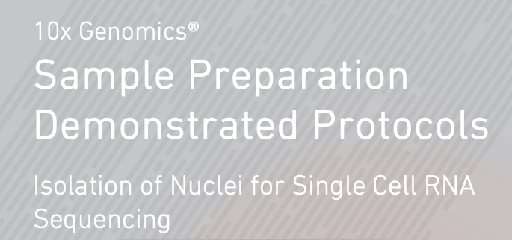
Many protocols available…
Start here:

Slide 8
Factors influencing success
Cell debris / dead cells
Clog microfluidics, free floating RNA → noise.
Aggregates
No longer single cell data.
Clog microfluidics.
Buffer
Inhibit polymerase → decrease library complexity.
Storage conditions
But the most important factor is cell / nuclei counting!

Slide 9
Workflow
Single cell suspension
Visually inspect cells
Microscope or automated cell counter
Filter, etc.
NO
Free of debris / live
YES
Count

Slide 10
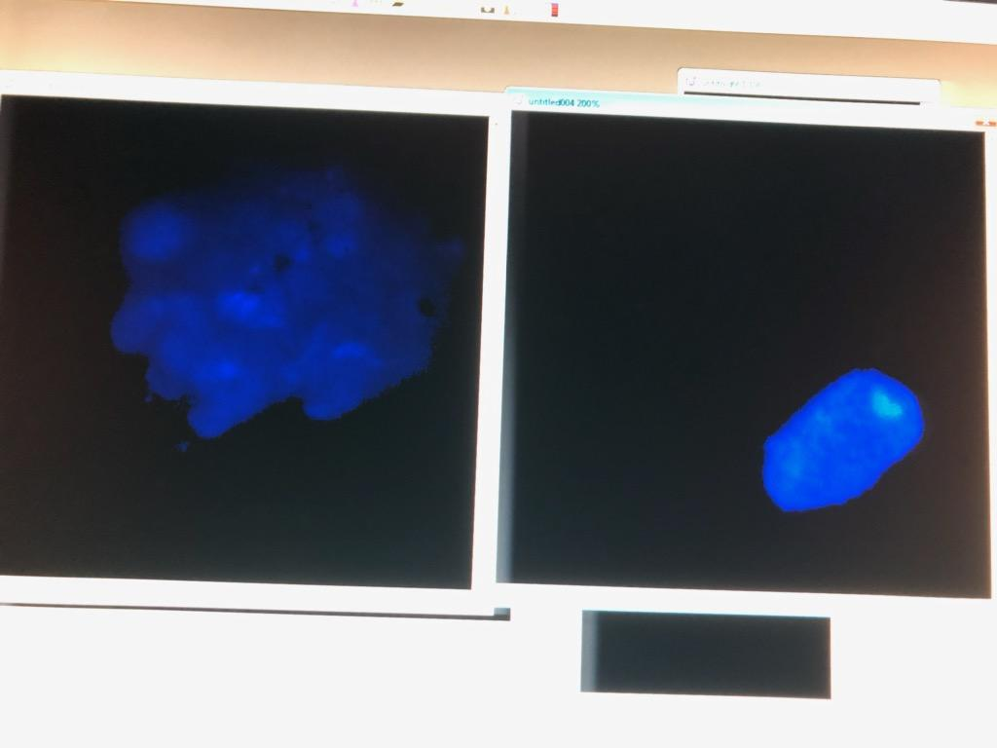
Tissue aggregates
DAPI stain
60X
No scale bar
Single nucleus
Tissue clump
Recommended treatment: optimize tissue dissociation

Slide 11
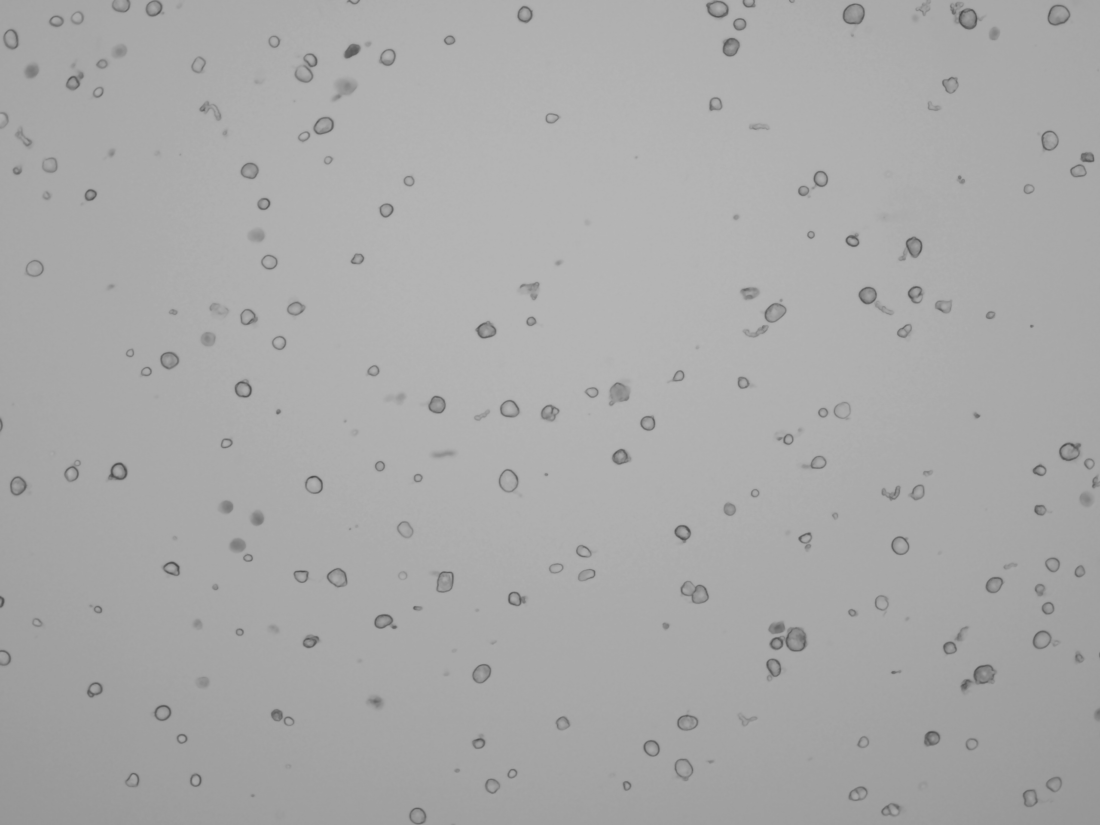
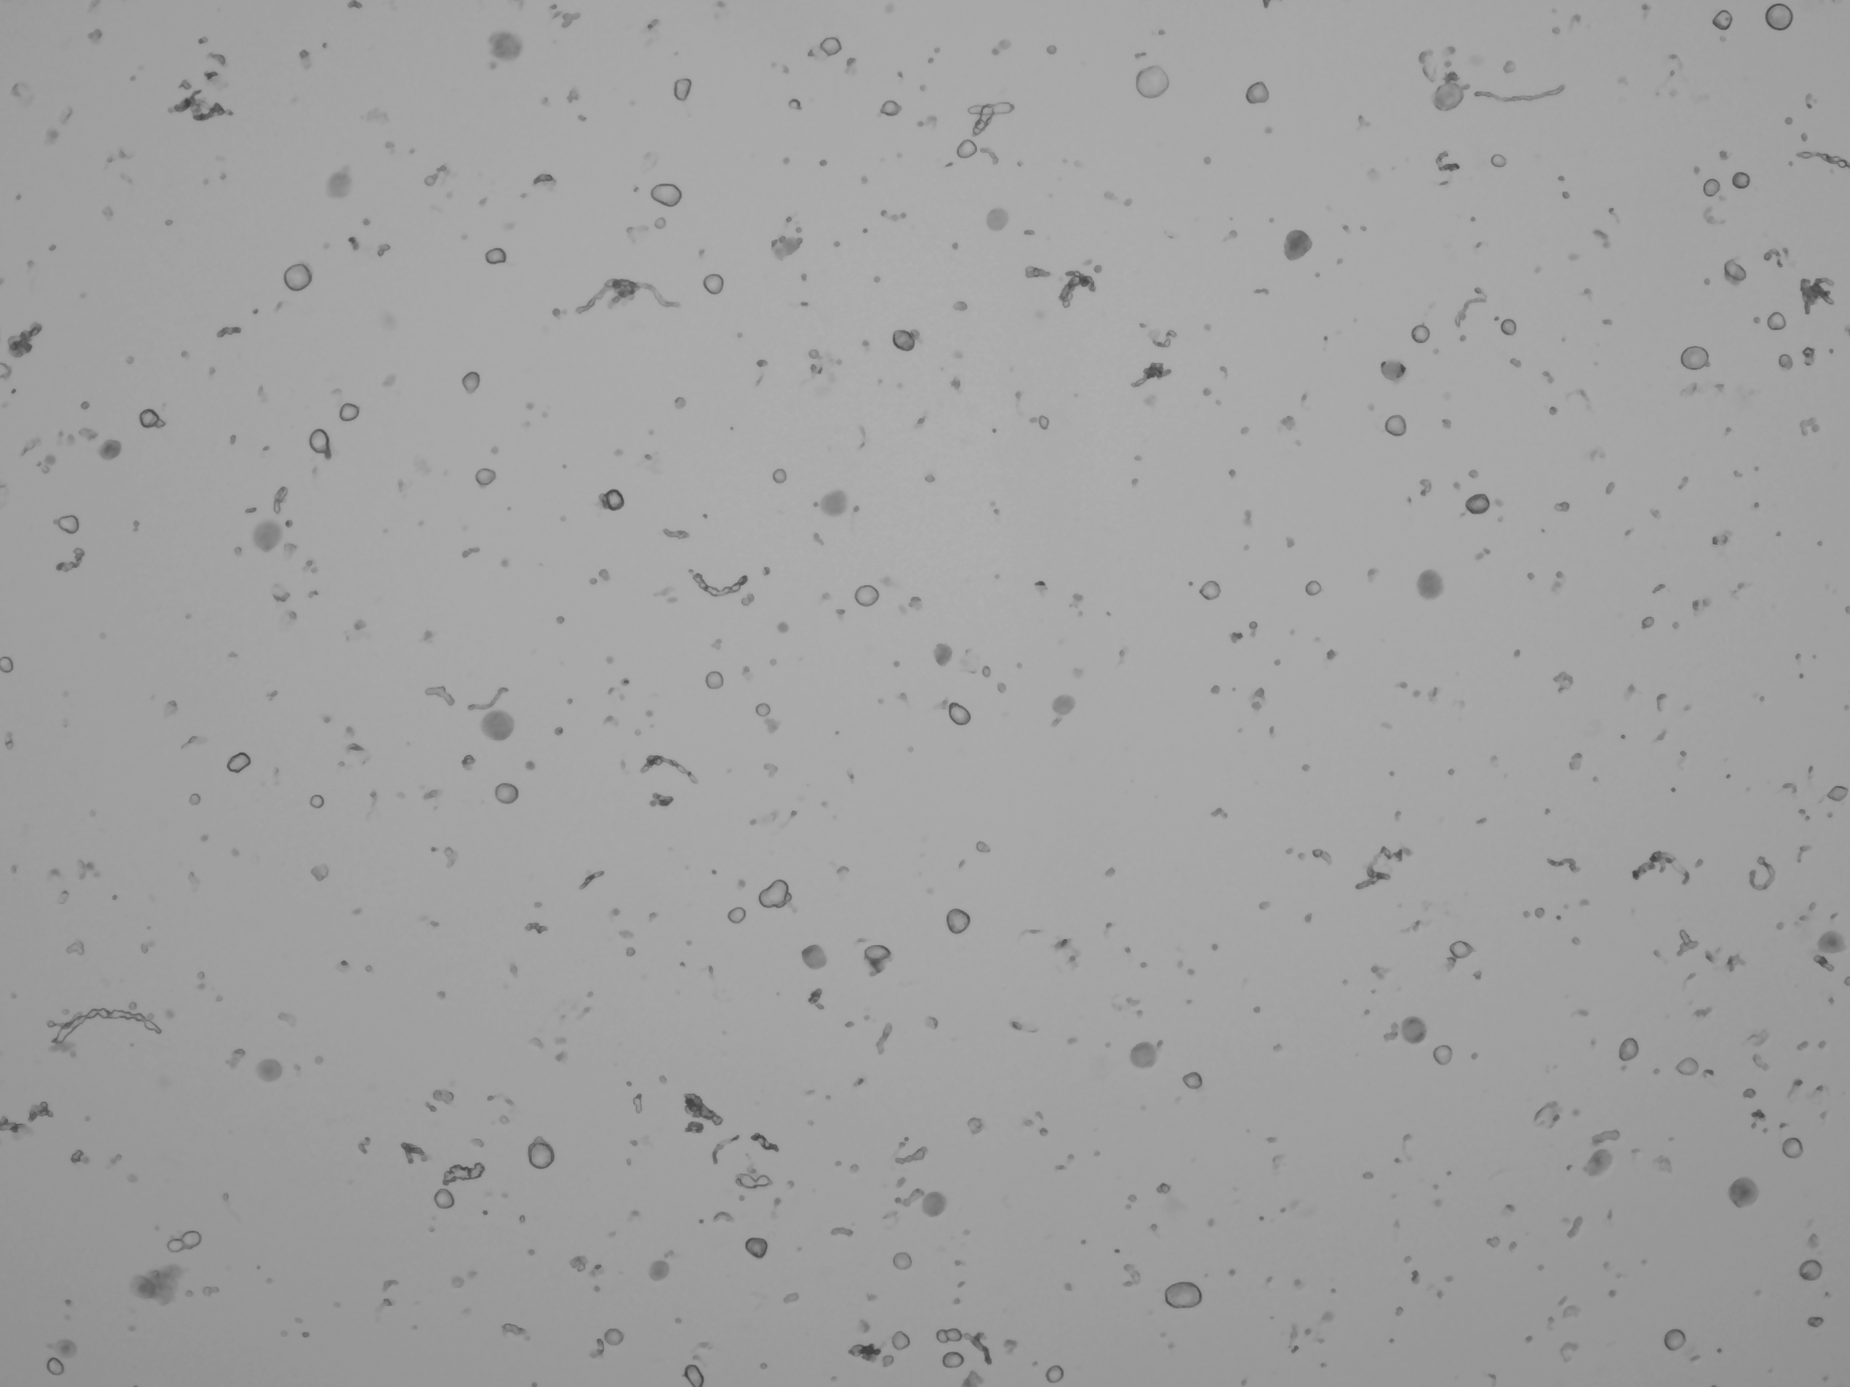
Cell debris
Mouse DRG.
Clean DRG sample Noisy sample
Recommended treatment: filtration, centrifuge, add blocking agent.

Slide 12
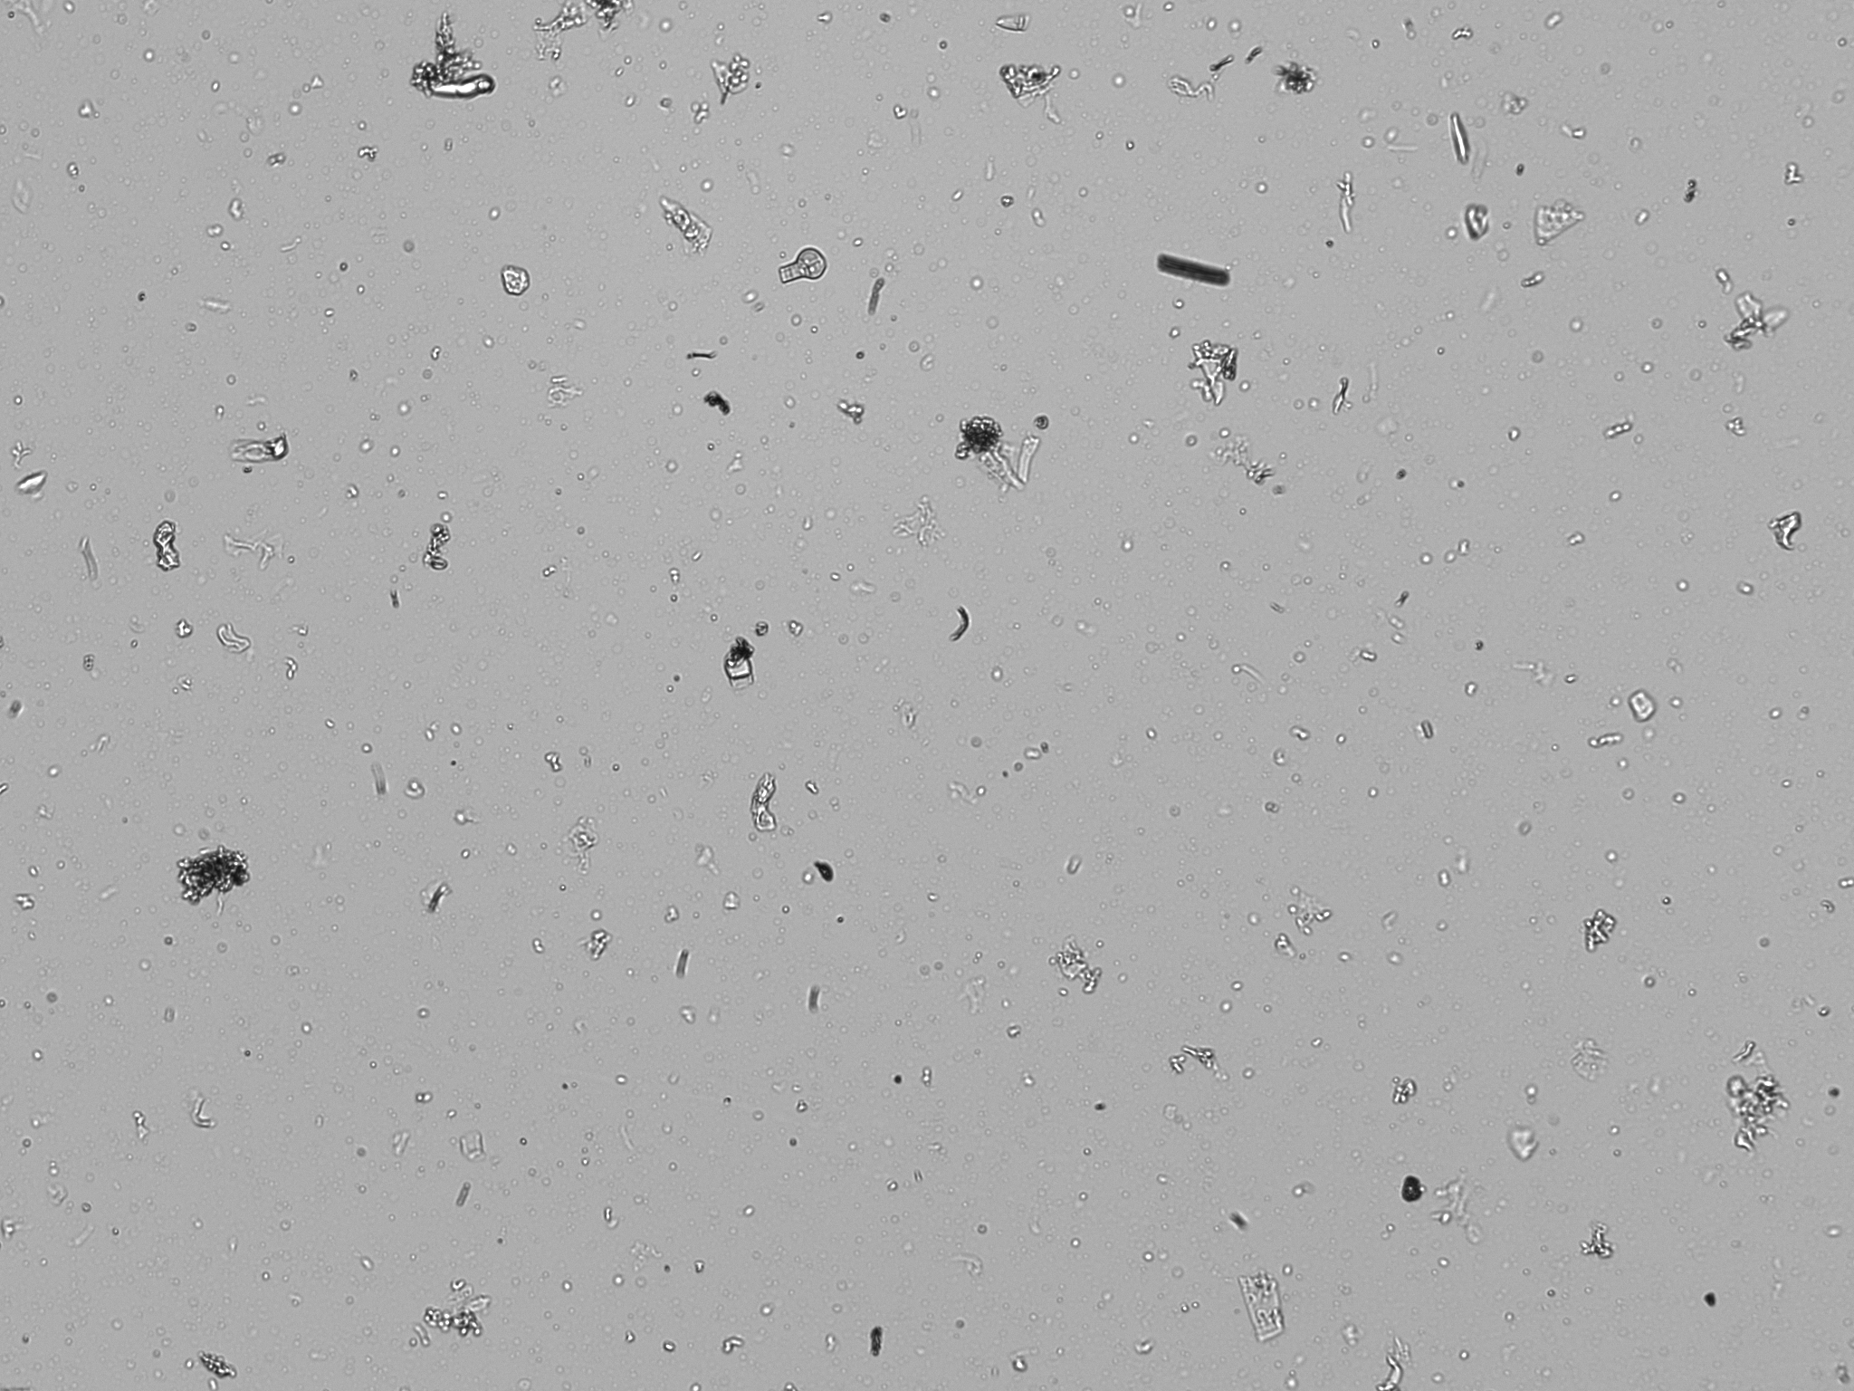
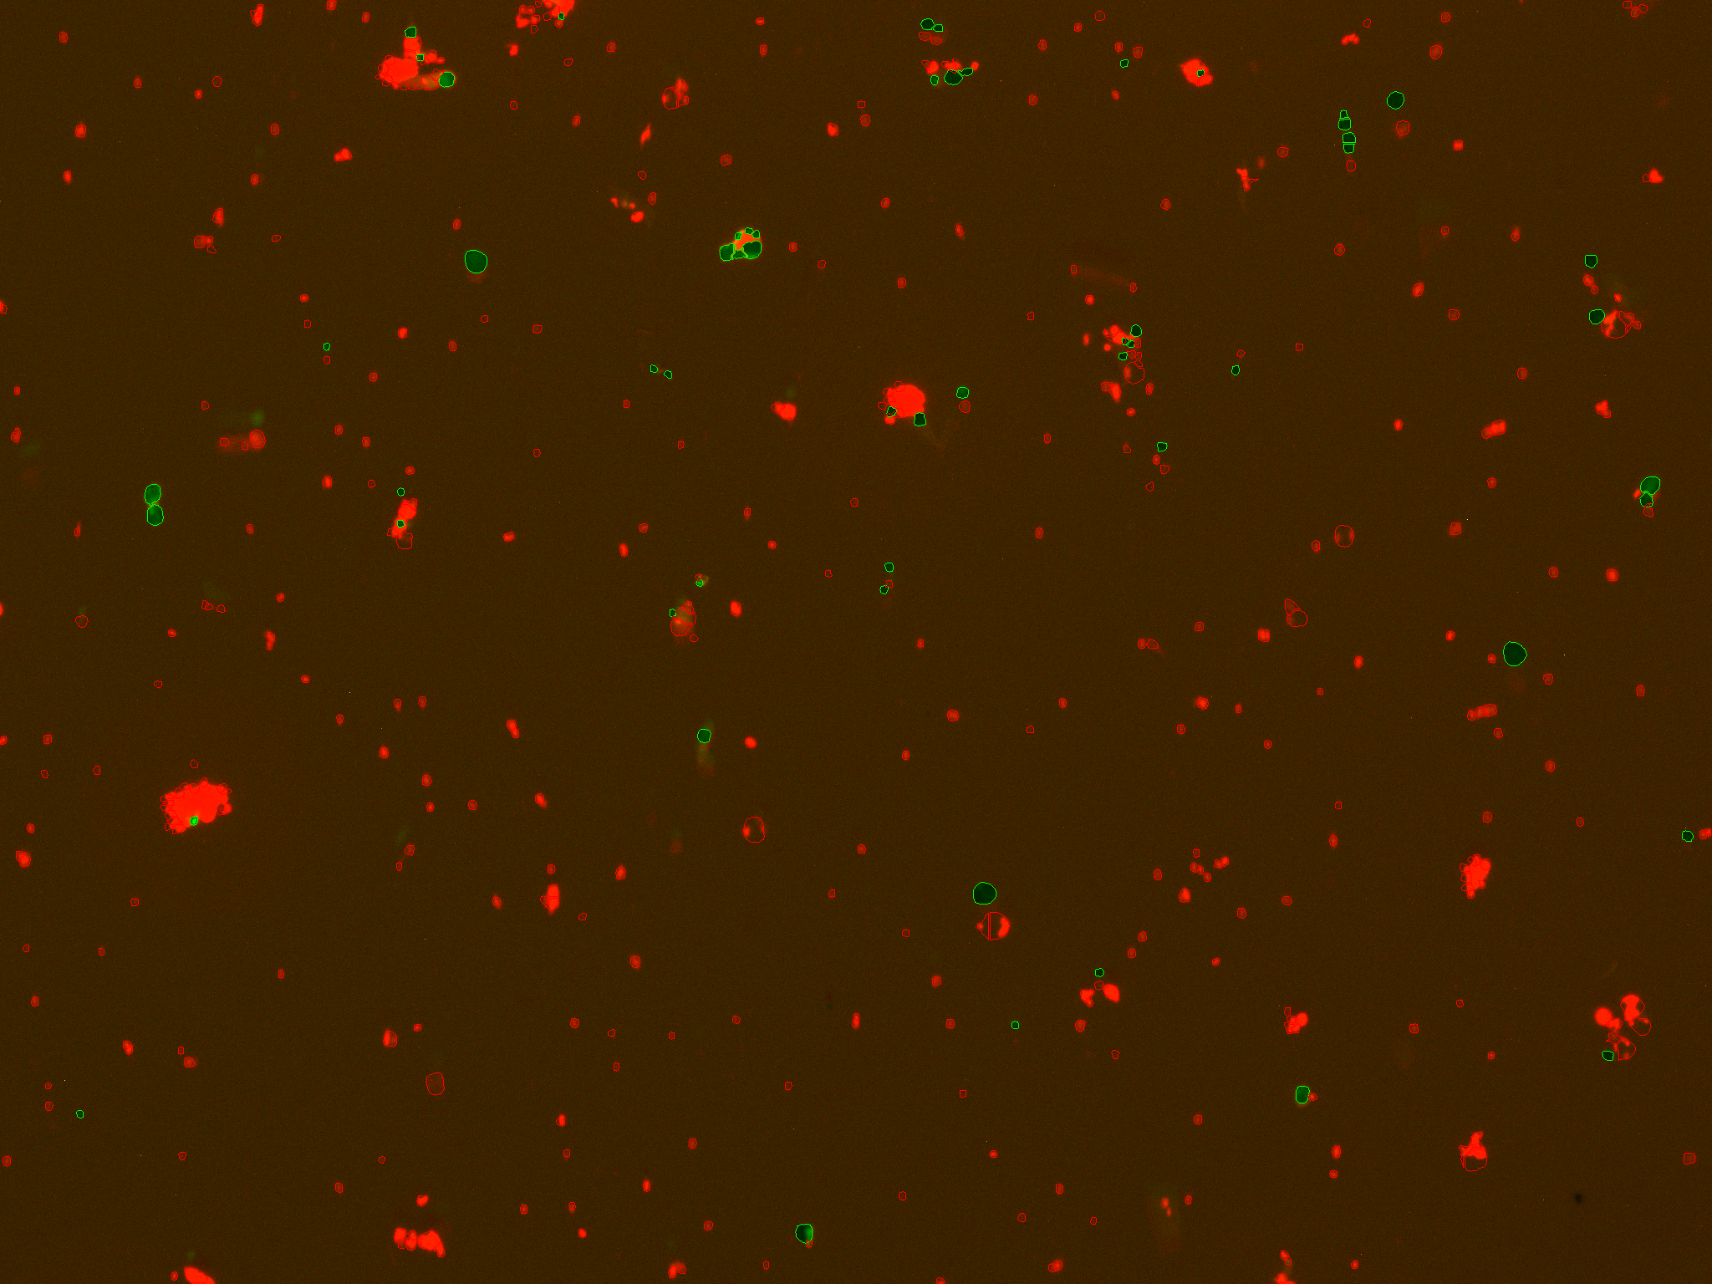
Cell debris II
Lettuce nuclei prep.
Photo credit: Mohan Prem Anand Marimuthu
Recommended treatment: modify dissociation times / detergent concentrations, change density gradient.

Slide 13
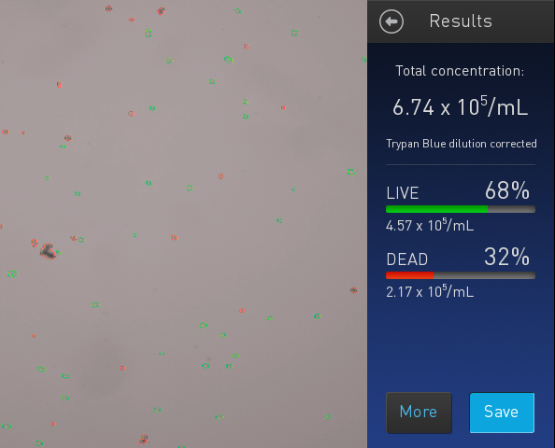
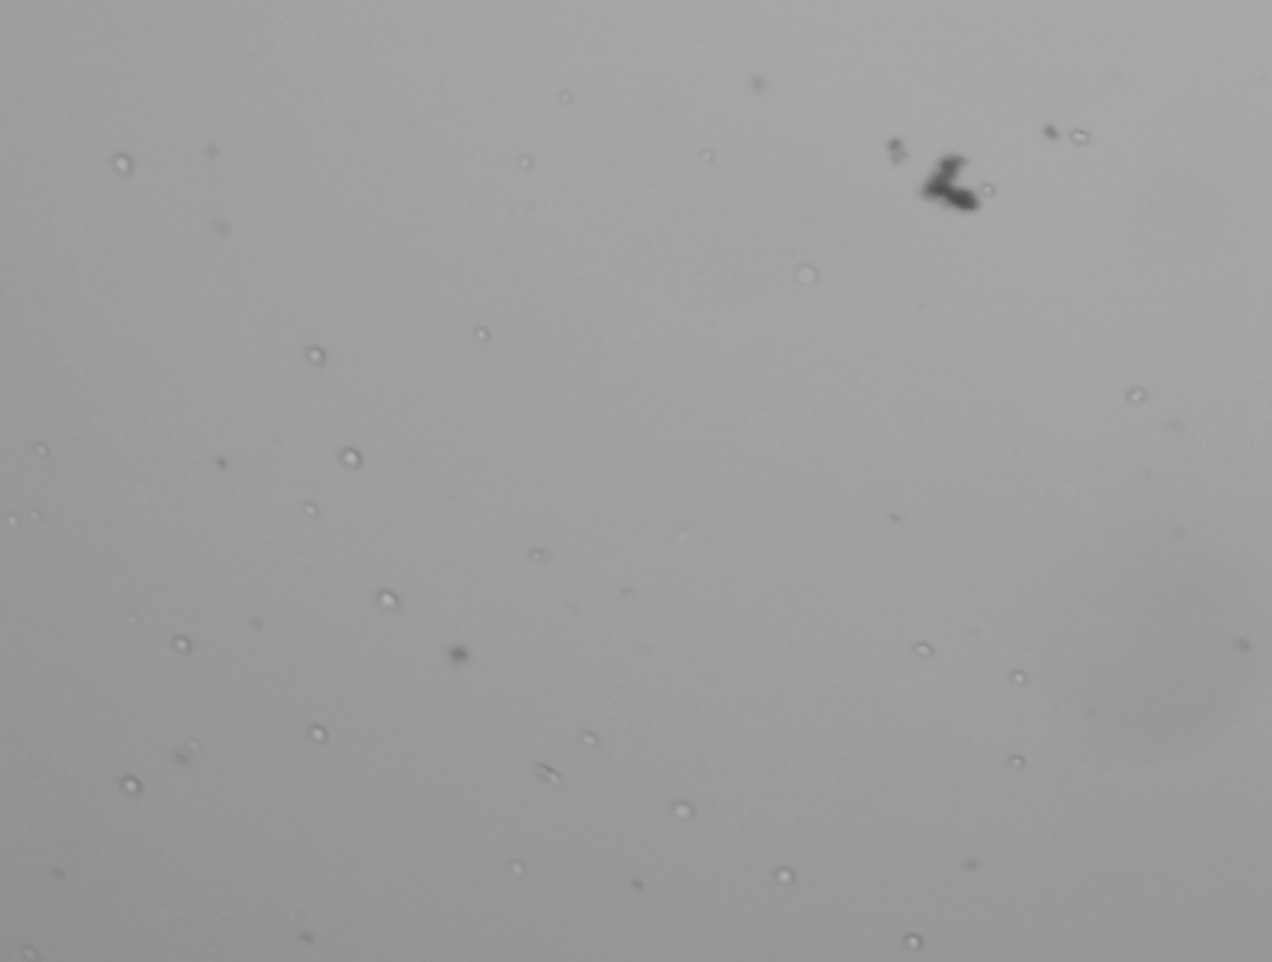
Dead cells (+debris?)
Recommended treatment: dead cell removal.
https://www.miltenyibiotec.com/US-en/products/dead-cell-removal-kit.html

Slide 14
Doublets
Non-single cell clumps.
Integrated into droplets and cannot* distinguish from single cells.
Doublet
Bad for any single cell experiment.
Recommended treatment: filtration, change [blocking agent]

Slide 15
Workflow
Single cell suspension
Visually inspect cells
Starting over >> manipulation
Filter
NO
Free of debris / live
YES
Count

Slide 16
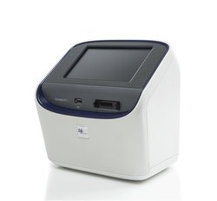
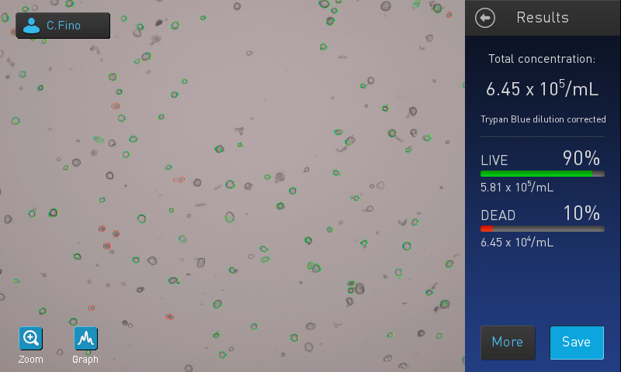
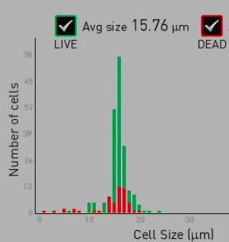
Automated counting
Countess II.
Pros (+):
Fast.
Live/dead cell counts.
Cell size estimates.
Cons (-):
Cell size limits (4-30um).
Doesn’t do well with odd cell shapes, debris, nuclei.

Slide 17
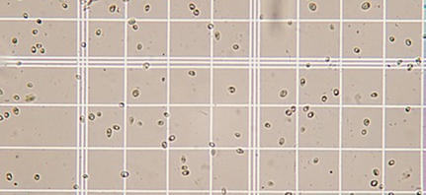
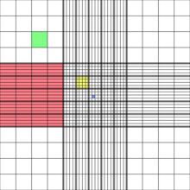
Manual counting
Hemocytometer.
http://www.wetnewf.org/pdfs/hemocytometer.html
Pros (+):
Reliable cell counts.
Count small cells.
Visualize cells vs. debris.
Cons (-):
Slow.

Slide 18
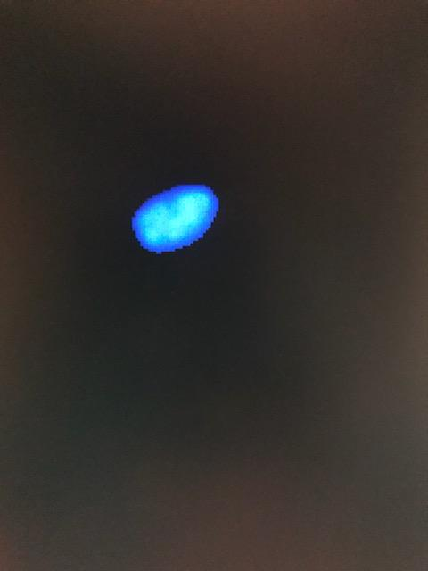

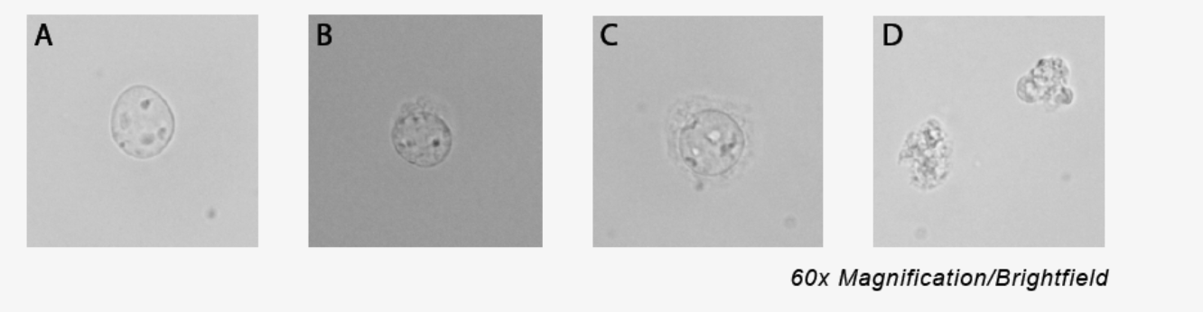
Nuclei QC
Use fluorescence.
Countess II FL, Devonix CellDrop, Luna FL.
Stains
Trypan blue → 100% dead (not great).
Ethidium homodimer stain (good for excluding debris).
DAPI, PI other options
60X: DAPI
Credit: 10X
Hemocytometer
CountessII

Slide 19
Cell sorting
FACS
Pros (+):
Sort live / dead.
Enrich cells of interest.
Determine whether correct cells isolated (qPCR works too).
Cons (-):
Overestimates cell counts (~2x).
https://flowcytometry-embl.de/cell-sorting/

Slide 20

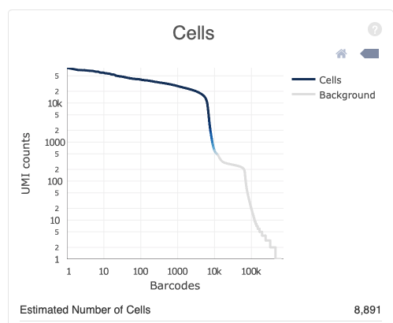

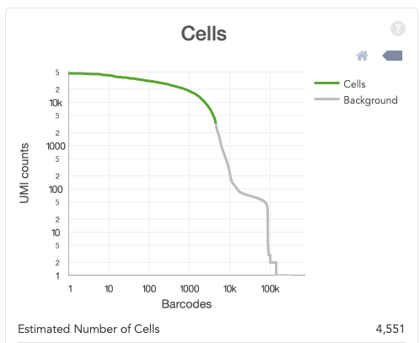
The good…

Slide 21
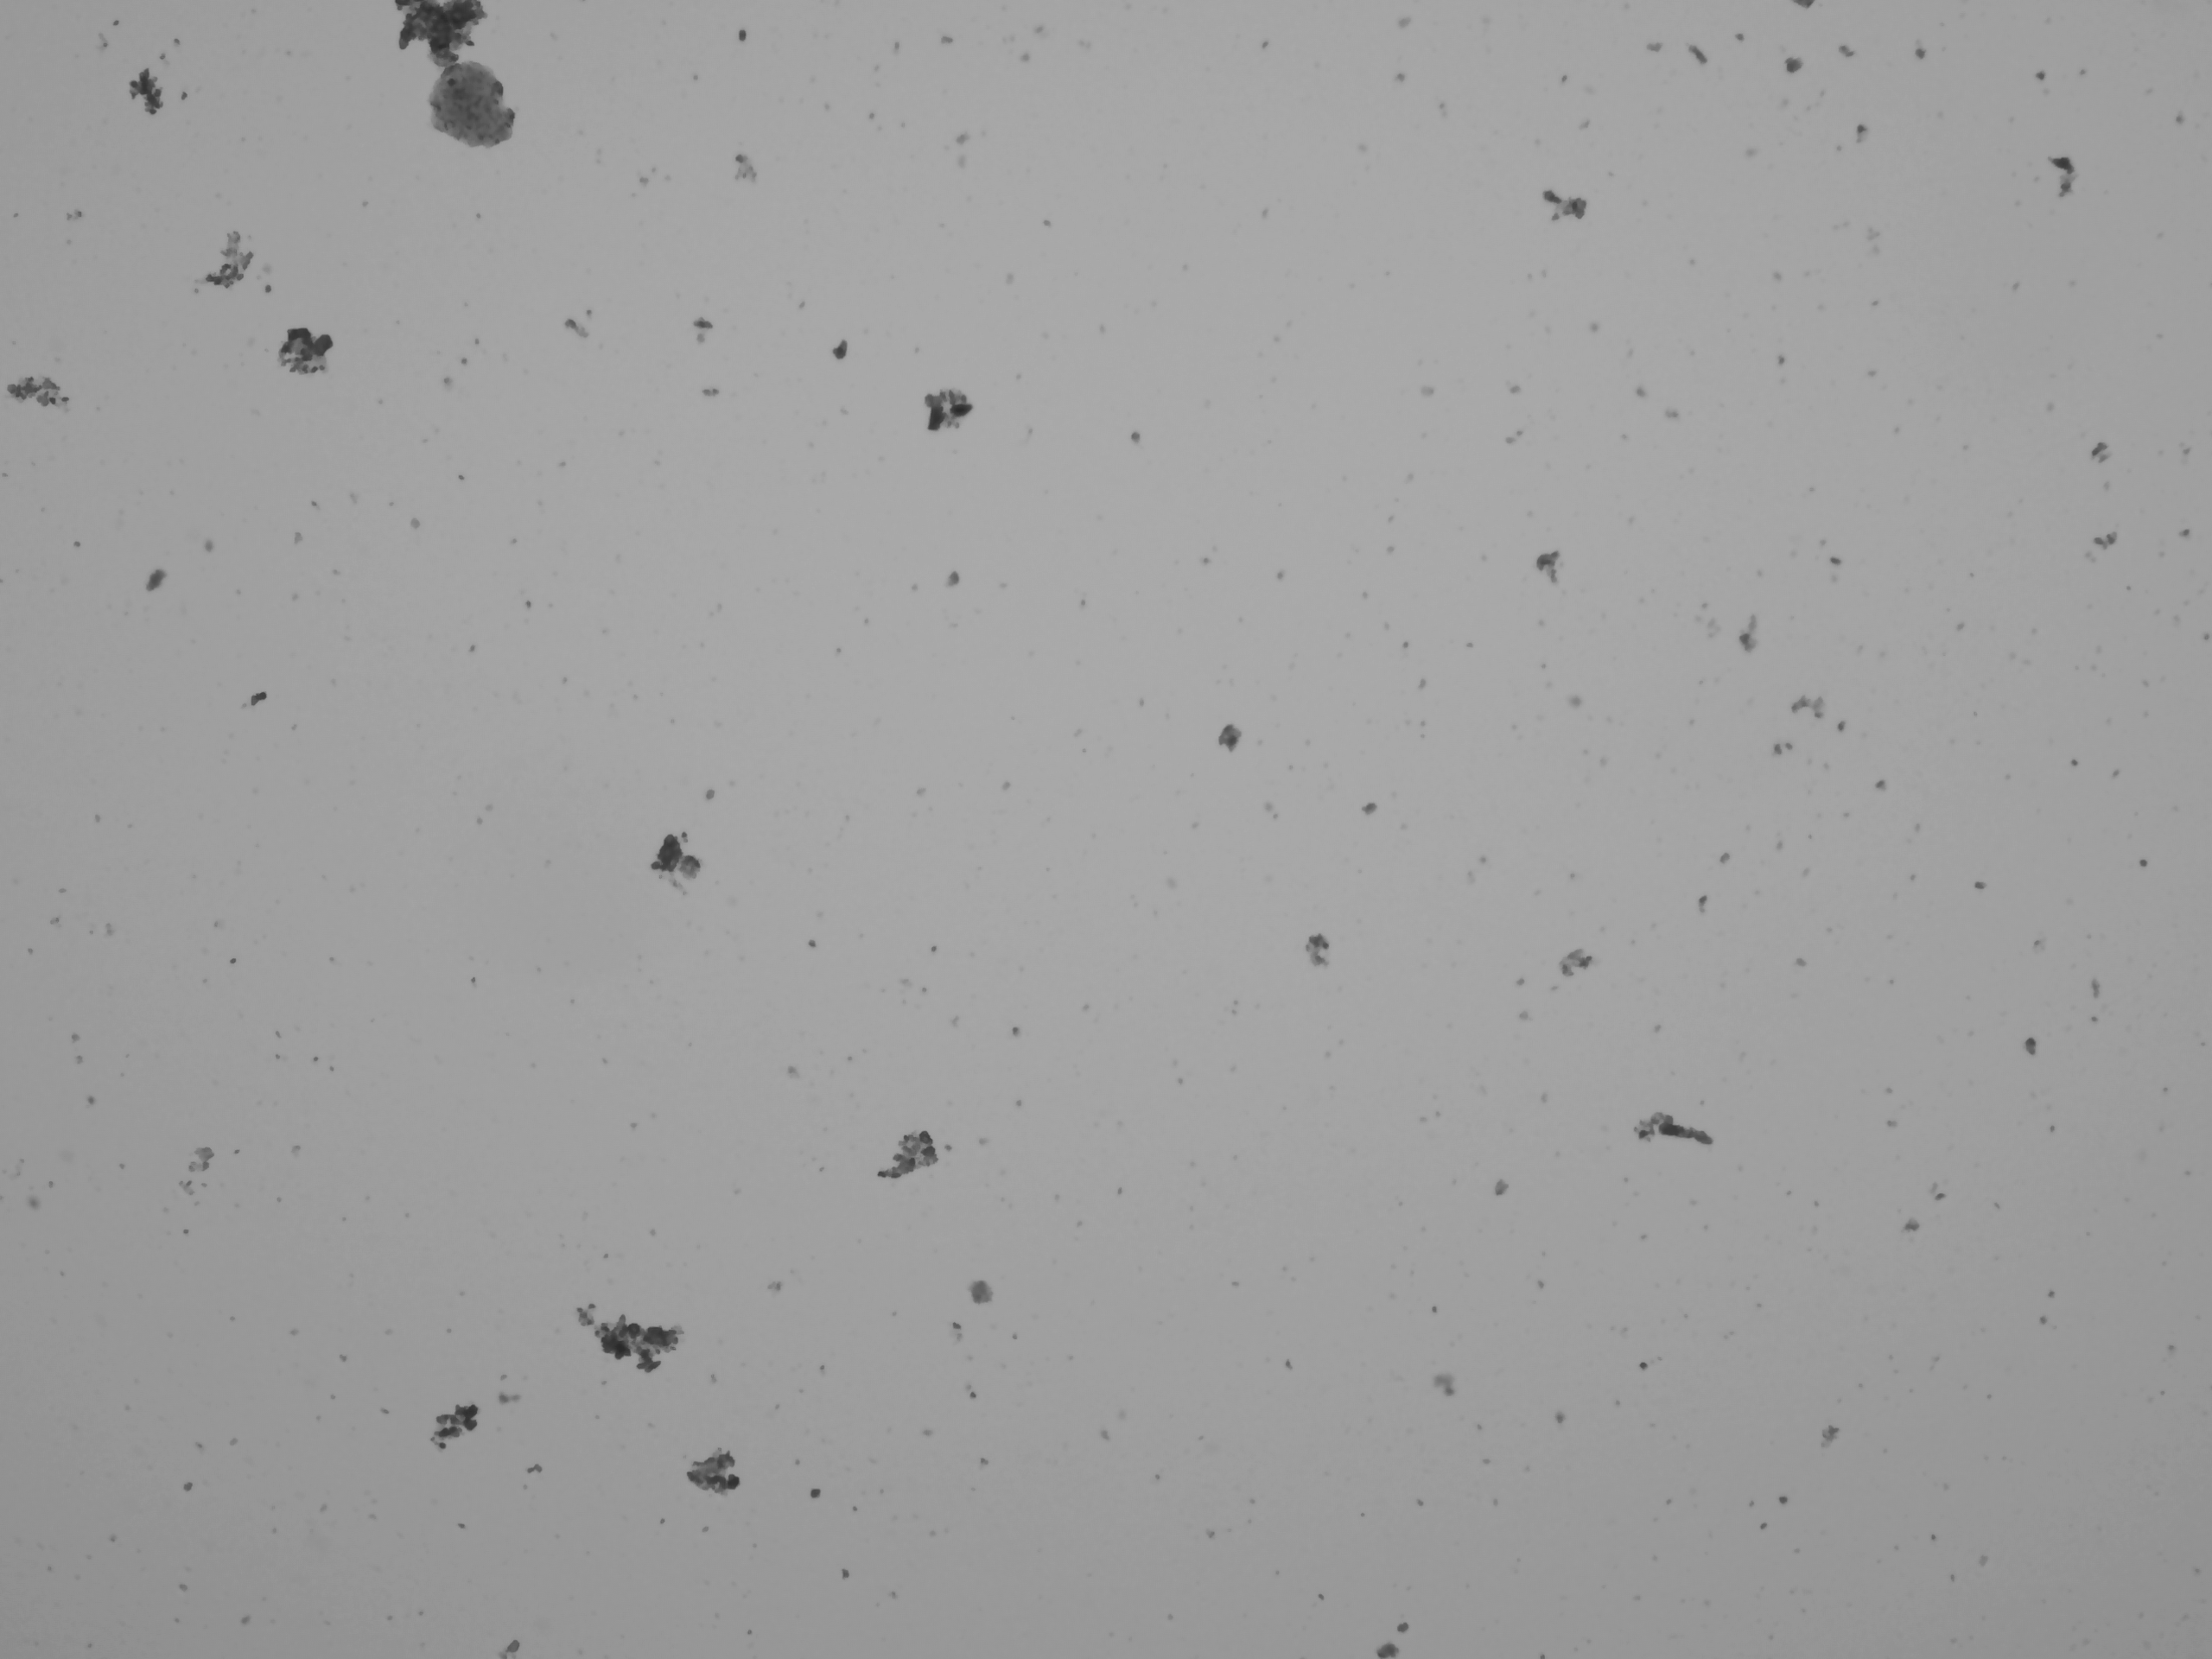
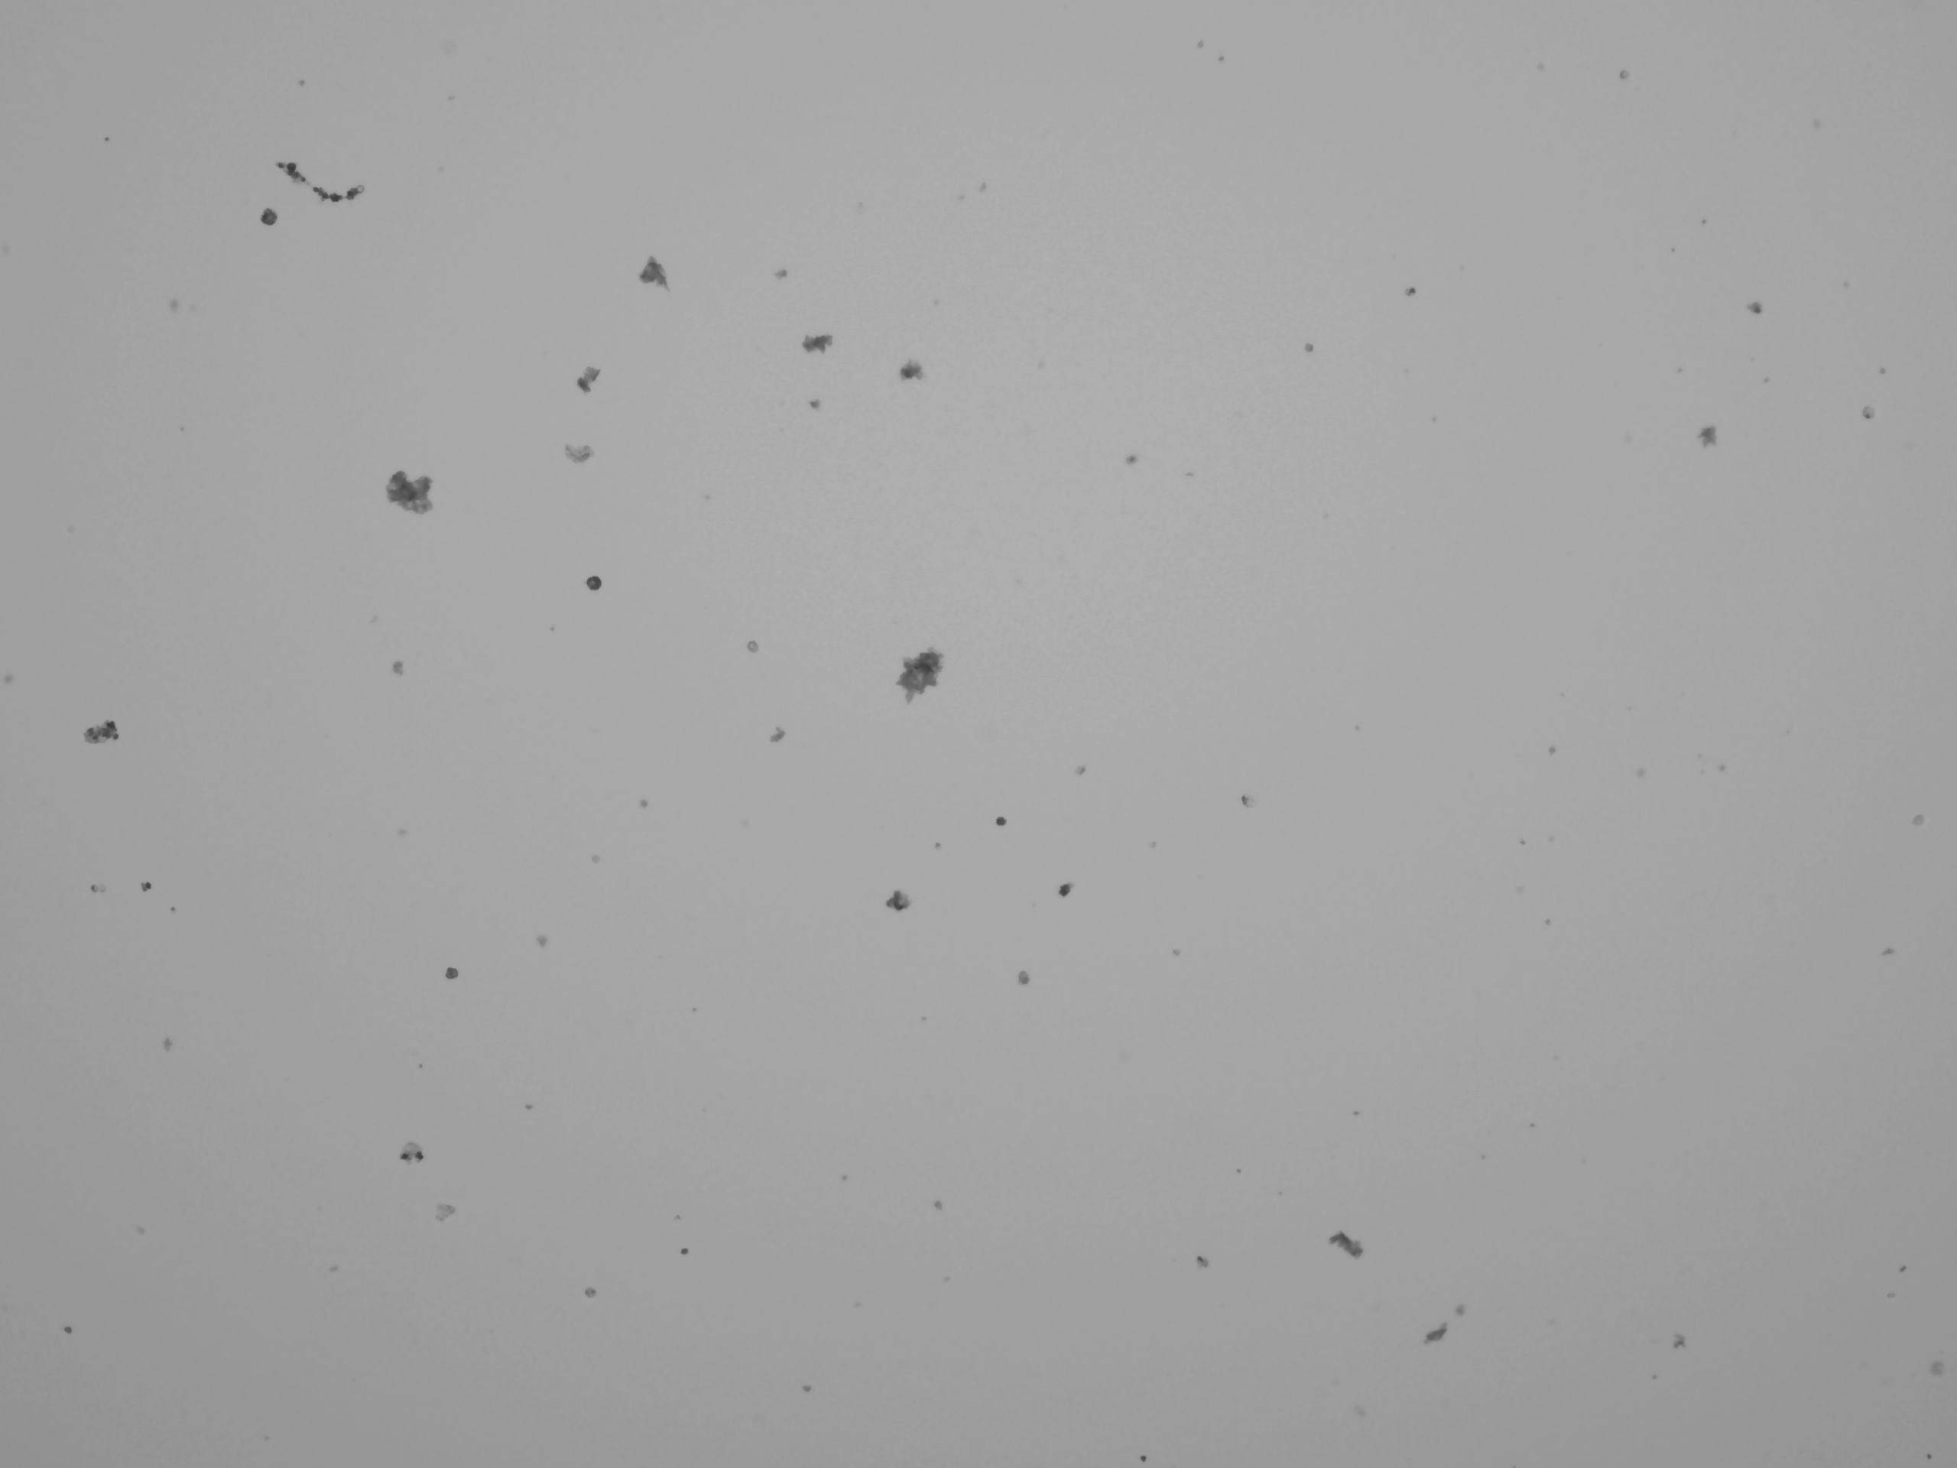

The bad…

Slide 22
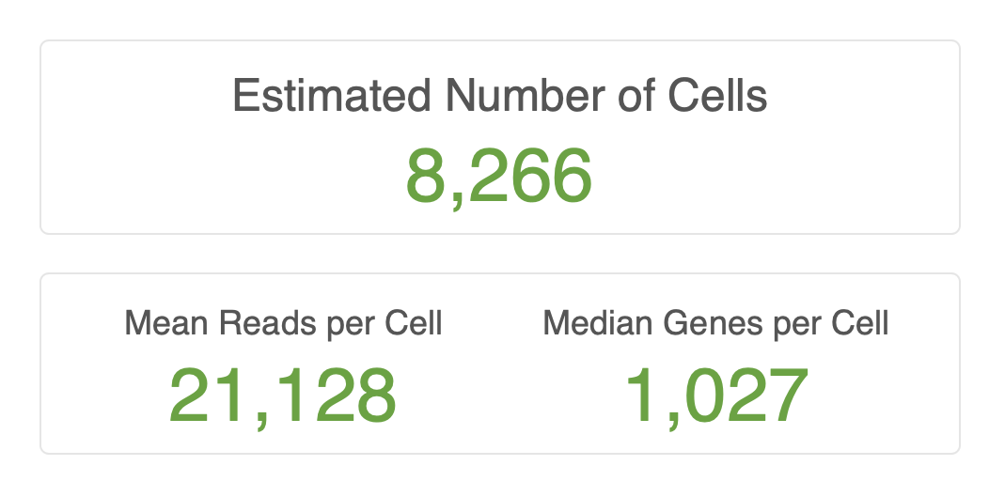



Challenges Cell Recovery
10X is optimized for model cell types – human PBMCs, etc.
Round, easy to count, size well below size of microfluidics.
These yield consistent results. 10K target. 8K-10K recovered.
But most experiments outside of culture don’t look like this.
Nuclei (100% dead)
Variable size, shape, and viability
Hydra
Human bone

Slide 23
How maximize output?
Carefully craft experimental design and sample prep .
QC cells before real sample set-up.
Concentration: aim for the median.
700-1,200 cells per µl optimal.
Too high → dilute.
Too low → tough one (concentration impacts yield, pooling replicates suboptimal).
Count in replicates (at least n=2).
Viability: 70% minimum.
Nuclei and methanol fixed cells (0%).
Treat cells gently.
Wide bore pipette tips, keep cells at preferred temp, work quickly.

Slide 24
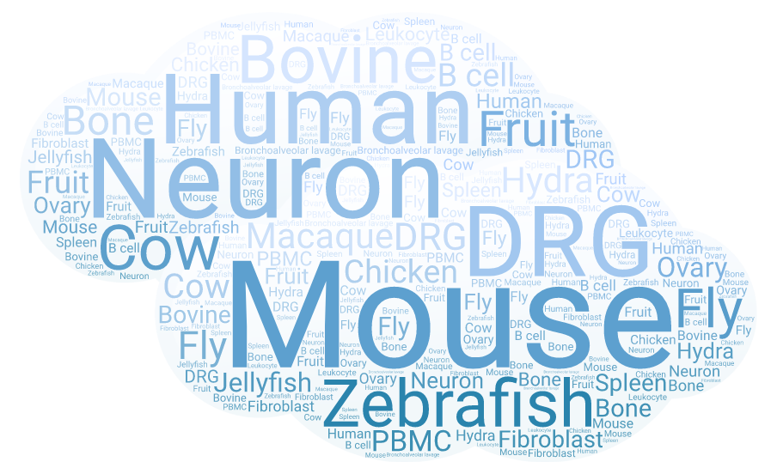
10X Single Cell Studies - DNATECH

Slide 25
Assay summary (organism)
78 projects since July 2017 (primarily 3’ GEX).
Sample distribution by organism
Bovine
Human
Mouse

Slide 26
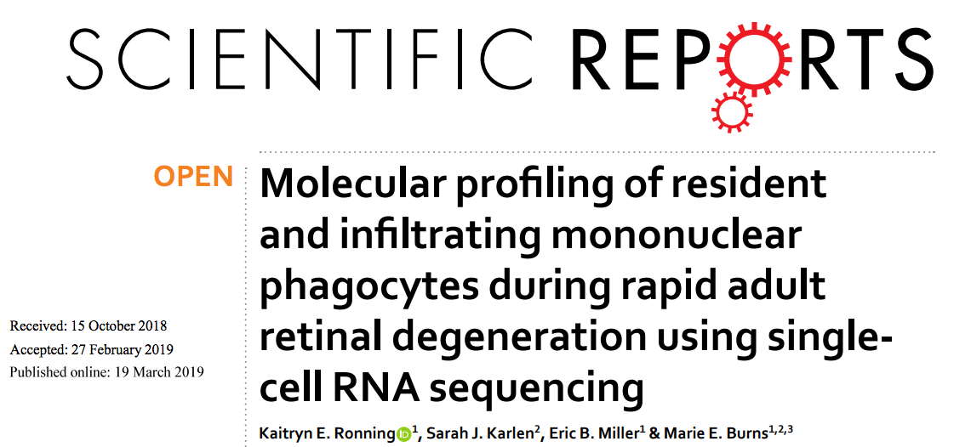
Retinal degeneration

Slide 27
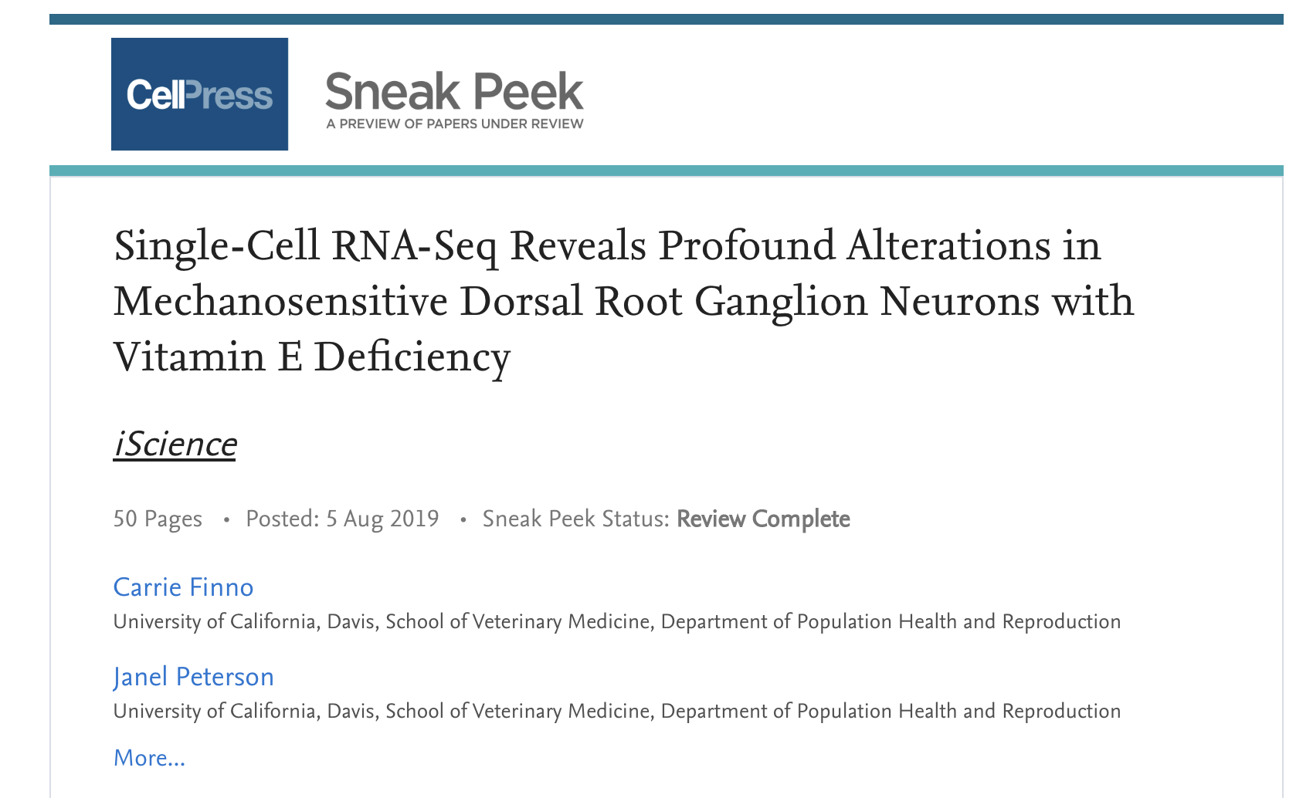
Vitamin E deficiency - DRG Neurons

Slide 28
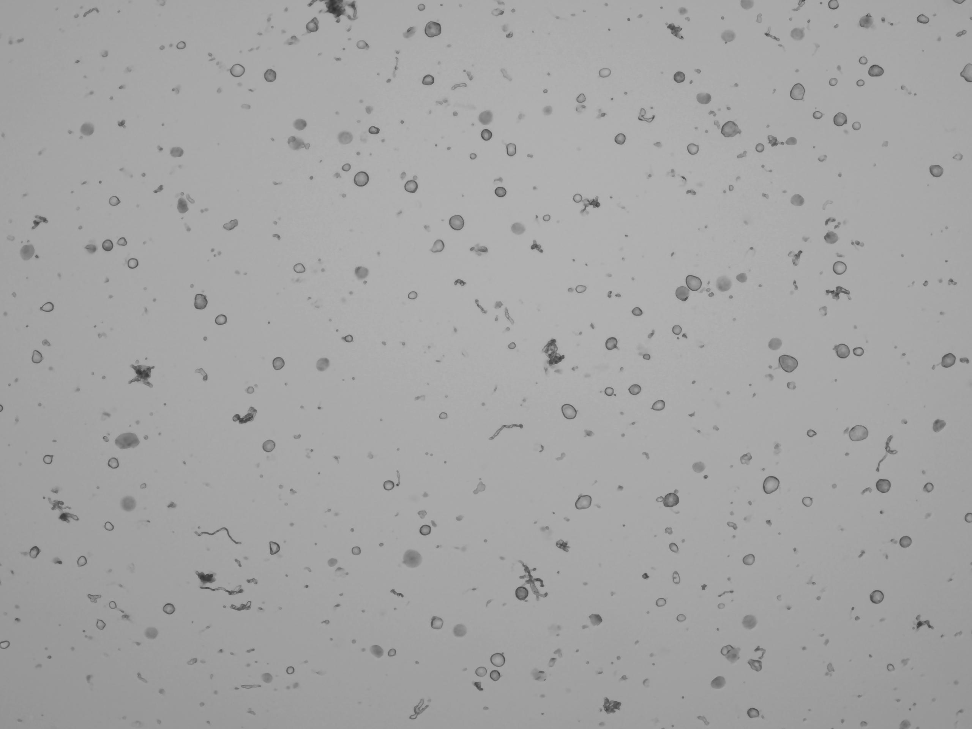
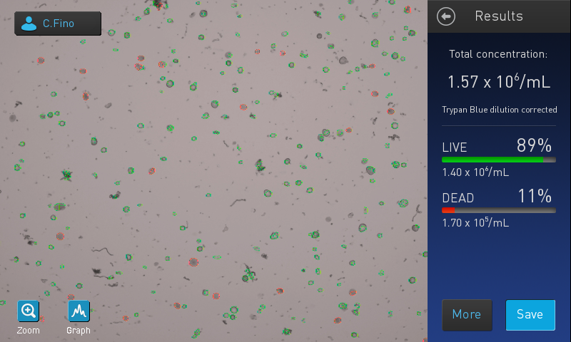
‘564’ – challenges and solutions
DRG fragile, difficult to count, odd sizes (clog 10X chip?).
Count manually → better counts.
Accepted some degree of induced technical variation
Prepped samples over three days.
Improved sample quality and reproducibility, introduced prep day variation.
As Matt mentioned mitigate with experimental design.

Slide 29
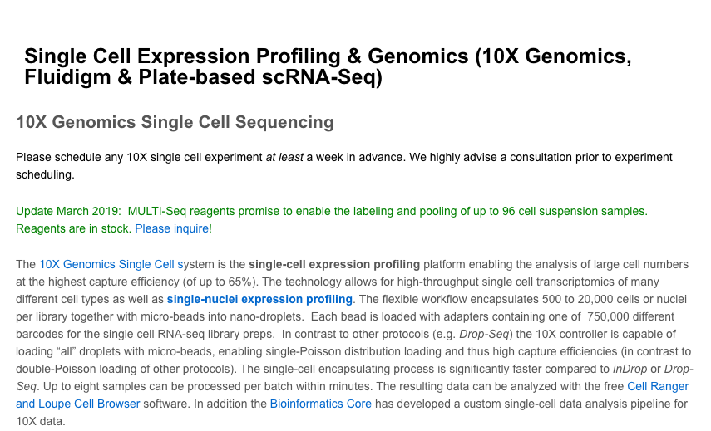
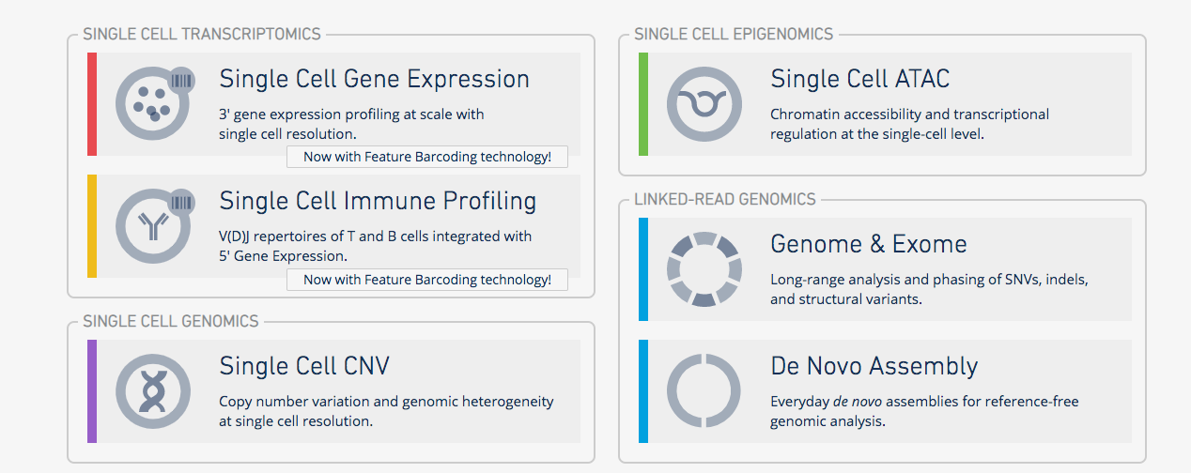
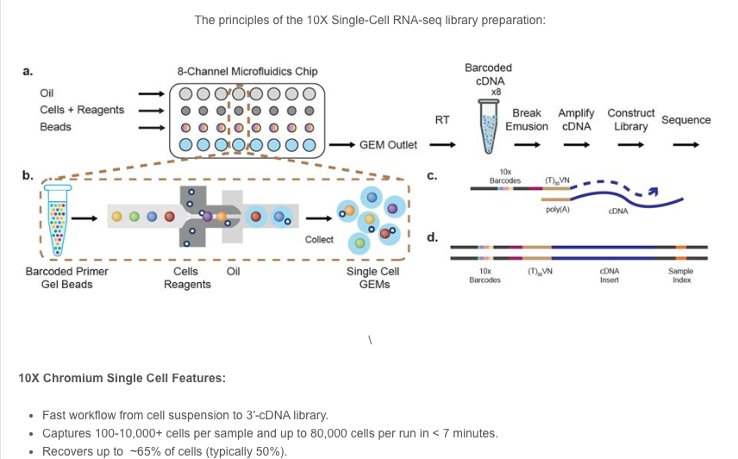
Important resources
10X Genomics
https://support.10xgenomics.com/single-cell-gene-expression
Paul Scott, Sales Executive (paul.scott@10xgenomics.com)
UC Davis Flow Cytometry
http://www.ucdmc.ucdavis.edu/pathology/research/research_labs/flow_cytometry/index.html
Bridget McLaughlin (Technical Director)
UC Davis DNA Technology Core
http://dnatech.genomecenter.ucdavis.edu/single-cell-analyses/
UC Davis Bioinformatics Core
https://bioinformatics.ucdavis.edu/

Slide 30
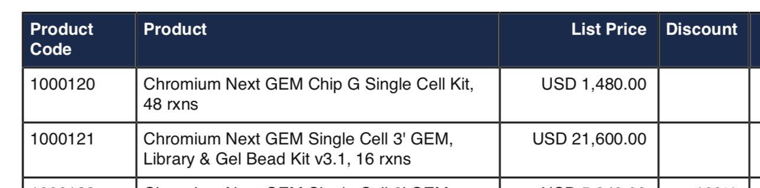
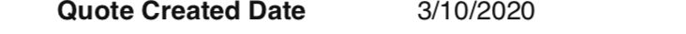
Cost 10X Reagents
Chips are single use (n=1 to n=8 samples) → $247 EACH
Reagents (n=1) → $1,350 EACH.
Total (n=1, reagents only): $1,597.
This doesn’t include you or your cores labor!
Sequencing? Bioinformatics?
Depends on many factors.
We charge $1,000 for 350M reads (~10K cells with 35K reads per cell).

Slide 31
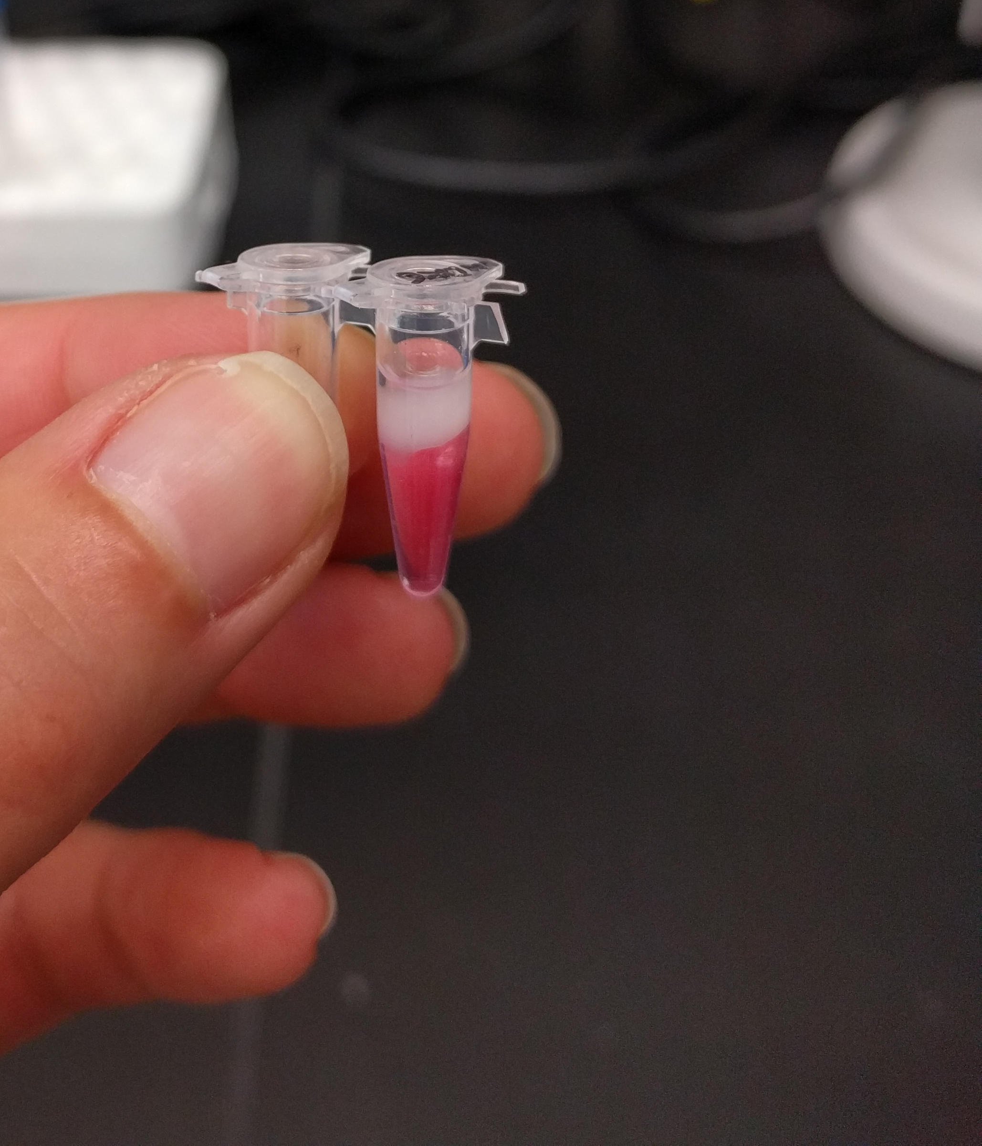
Acknowledgements
UC Davis DNA Technology Core team.
UC Davis Bioinformatics Core team.
10X Genomics.
Adam Bemis (Field Applications Scientist)
Paul Scott (Sales Executive)
Nicole Abreu (Technology Advisor)

